Slide 1
ENERGY CONSUMPTION FORECAST
(A Machine Learning & Time Series Forecasting Project)

Slide 2
Mentor’s :
Prajwal A N.
Karthik Muskula.
Team Members:
Chetan Yogesh Wagh.
Shivani Rakesh Kalghatgi.
T. Goutham
Manojkumar M Gondakar.
Sahil Gottimukkala.
Akhil T.

Slide 3
Project Overview
Forecasting daily energy demand is essential for managing electricity supply.
Helps prevent power outages and supports efficient resource planning.
Uses historical hourly consumption data from PJM Interconnection (USA).
Applies machine learning & time-series forecasting techniques.
Deployed as an interactive Streamlit web app.

Slide 4
Goal
Build an accurate and reliable machine learning model to forecast daily energy consumption for the PJM region.
Support energy providers & planners in optimizing supply.
Reduce operational costs.
Prevent power shortages.

Slide 5
Objectives
Analyze & preprocess historical hourly data.
Resample to daily format for stability.
Engineer time-based features: lag values, rolling averages, day-of-week and month.
Evaluate multiple forecasting models for accuracy & efficiency.
Deploy a user-friendly Streamlit app for forecasting & visualization.

Slide 6
Dataset Overview
Source : PJMW_MW_Hourly
Period : April 1, 2002 - August 3, 2018.
Size : 143,206 rows, 1 columns
Features : Datetime (hourly), PJMW_MW (MW demand)
Missing Values : None

Slide 7
Dataset Features
Datetime : Timestamp of hourly readings (YYYY-MM-DD HH:MM:SS format).
PJMW_MW : Electricity demand in megawatts (MW).
Frequency : Hourly observations.
Time Range : April 1, 2002 - August 3, 2018.
Units: MW (megawatts).
Datetime | PJMW_MW
2002-04-01 01:00:00 | 4374
2002-04-01 02:00:00 | 4306
2002-04-01 03:00:00 | 4322
2002-04-01 04:00:00 | 4359
2002-04-01 05:00:00 | 4436

Slide 8
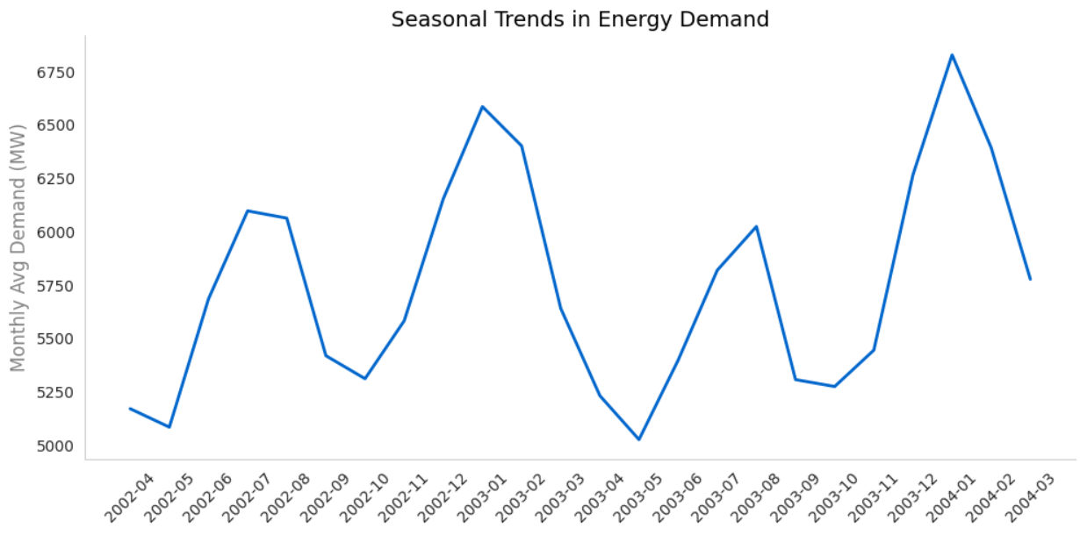
EDA: Seasonal Trends
Demand peaks in summer months due to increased cooling needs.
Demand drops in spring and fall.
Annual patterns repeat consistenly, indicating strong seasonality.
Seasonal insights support effective feature engineering and model selection.

Slide 9
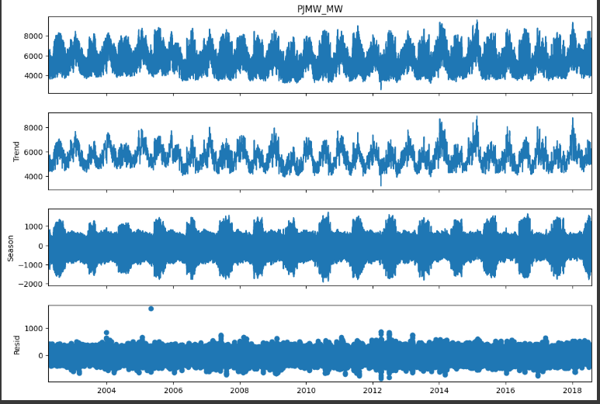
EDA: Visualizations
Trend : Long-term pattern mostly stable with slight seasonal fluctuations.
Season : Clear repeating yearly cycles (higher in winters/summers, lower in springs/falls).
Residual : Mostly small random noise, some spikes indicate unusual events.

Slide 10
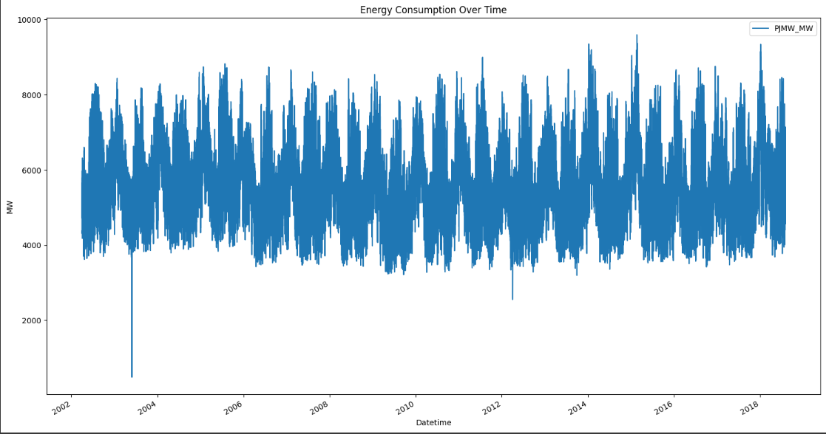
EDA: Daily Patterns
Time Range : 2002–2018 hourly data.
Pattern : Clear seasonal cycle (summer/winter peaks, spring/fall dips).
Average Load : Mostly 4,000–7,000 MW.
Outliers : some sudden drops (data errors/missing values).
Trend : Long-term mostly stable with seasonal variations.

Slide 11
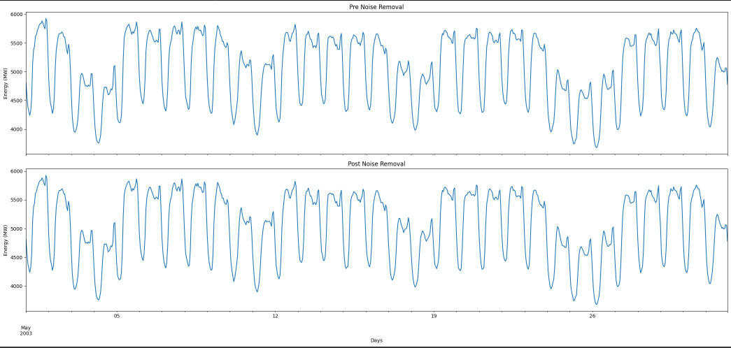
EDA: Noise Removal Before and After
Raw data graph shows spikes and irregular fluctuations caused by noise.
Applied rolling mean smoothing with a 7-day window to reduce noise.
Noise removal enhances clarity and reveals underlying trends.
Cleaned data helps improve the accuracy and reliability of forecasting models.

Slide 12
Feature Engineering Overview
Created extra features after EDA to capture data patterns.
Added lag_1 and lag_2 to include recent consumption history.
Used a 3-day rolling average to smooth sudden changes.
Added Day of Week to capture weekly patterns.
Added Month to capture seasonal trends.
Removed missing values during feature creation.
Combined short-term (lags) and long-term (seasonal) patterns for better model accuracy.

Slide 13
Feature Details
Short-term lags (lag_1, lag_2) capture immediate trends—most influential for near-future prediction
Seasonal & weekly patterns (month, dayofweek) boost long-term accuracy by modeling recurring cycles
Rolling averages smooth out noise—help stabilize predictions
Hour of day adds granularity—captures daily usage peaks and troughs
Previous day’s same hour value (e.g., lag_24) helps model daily repetition patterns.
Feature Name | Description
lag_1 | Previous day’s energy consumption (MW) – captures immediate trend.
lag_2 | Energy consumption from 2 days ago – helps track short-term shifts.
rolling_mean_3 | Average of last 3 days’ consumption – smooths sudden changes.
dayofweek | Day of the week (0=Mon … 6=Sun) – captures weekly usage patterns.
month | Month of the year (1–12) – captures seasonal variations (summer/winter demand).

Slide 14
Model Building Process
Data preprocessing and feature engineering.
Train-test split for model evaluation.
Model selection and hyperparameter tuning.
Model training and validation.
Performance evaluation using relevant metrics.

Slide 15
ARIMA Model
ARIMA was tuned with optimal p, d, q values using AIC minimization. It performed well on stationary data and captured linear trends effectively. Forecasts were stable, and it handled short-term predictions with decent accuracy.
But it was rejected because :
Struggled with seasonality needed manual seasonal adjustments or SARIMA.
Missed non-linear patterns couldn’t capture complex fluctuations in the data.
Preprocessing-heavy required stationarity checks, differencing, and tuning.

Slide 16
Holt-Winters Model
Holt-Winters was applied with additive seasonality and trend components. It handled level, trend, and seasonality well, and gave stable predictions with low error metrics. It was super fast to train and easy to implement no scaling or reshaping needed.
But it was rejected because :
Underfitted sudden spikes or drops couldn’t adapt to abrupt changes in the data.
Lacked flexibility fixed seasonal structure didn’t capture evolving patterns.
Limited long-term forecasting performance dropped when predicting far ahead.

Slide 17
Prophet Model
Prophet was applied with automatic trend, seasonality, and holiday detection. It worked well for recurring patterns and gave clear, interpretable components. No complex preprocessing was required.
But it was rejected because:
Missed sudden spikes or drops in demand.
Less accurate than XGBoost and LSTM for hourly forecasts.
Performance weakened for longer-term predictions.

Slide 18
LSTM Model
LSTM model was built using a 24-hour lag input and a single layer with 32 neurons. It captured short-term dependencies well and showed decent performance in terms of MAE and RMSE. With scaled data, it trained quickly and converged efficiently.
But it was rejected because :
Slower inference time not ideal for real-time or fast predictions.
No complex patterns in the dataset simpler models like Holt-Winters gave similar accuracy.
Higher implementation complexity required more effort (scaling, reshaping, tuning) for comparable results.

Slide 19
XGBoost Model
XGBoost used the last 24 hours as lag features and trained with 100 estimators. It delivered low MAE and RMSE, showing strong predictive power. It handled non-linear patterns and sudden shifts far better than traditional models.
It was selected Because :
Captured complex patterns great at modeling non-linear relationships.
Consistently low errors outperformed others in both MAE and RMSE.
Fast & scalable quick training and efficient inference.
No need for scaling or stationarity checks plug-and-play with raw data.

Slide 20
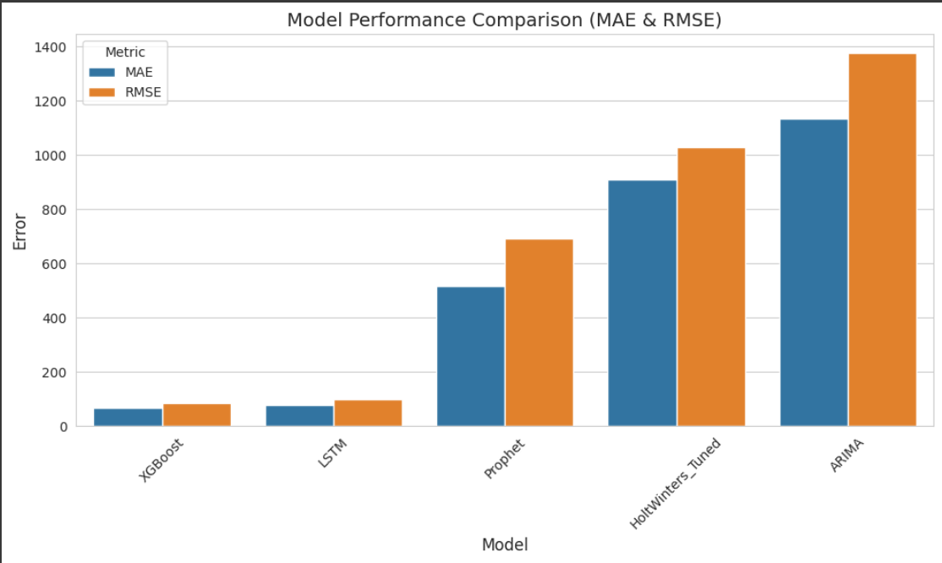
Model Comparison Table
XGBoost achieved the lowest error (both MAE & RMSE), making it the best performing model overall.
LSTM also performed well, slightly behind XGBoost, but with low errors compared to traditional statistical models.
Prophet had moderate errors, better than Holt-Winters and ARIMA, but significantly worse than XGBoost and LSTM.
Holt-Winters (Tuned) performed worse, with high MAE & RMSE, showing difficulty in handling sudden demand changes.
ARIMA had the highest errors, indicating it’s the least suitable for this dataset.

Slide 21
Deployment Overview
The trained XGBoost model is saved and integrated into a pipeline for real-time or batch forecasting. Input data is preprocessed with lag features, sent to the model, and predictions are returned instantly.
Key Highlights:
Model saved using joblib for reuse.
Reusable pipeline ensures consistent preprocessing and prediction.
API ready for deployment via Flask/FastAPI in real-time scenarious.
Monitoring setup tracka MAE/RMSE and detects data drift over time.

Slide 22
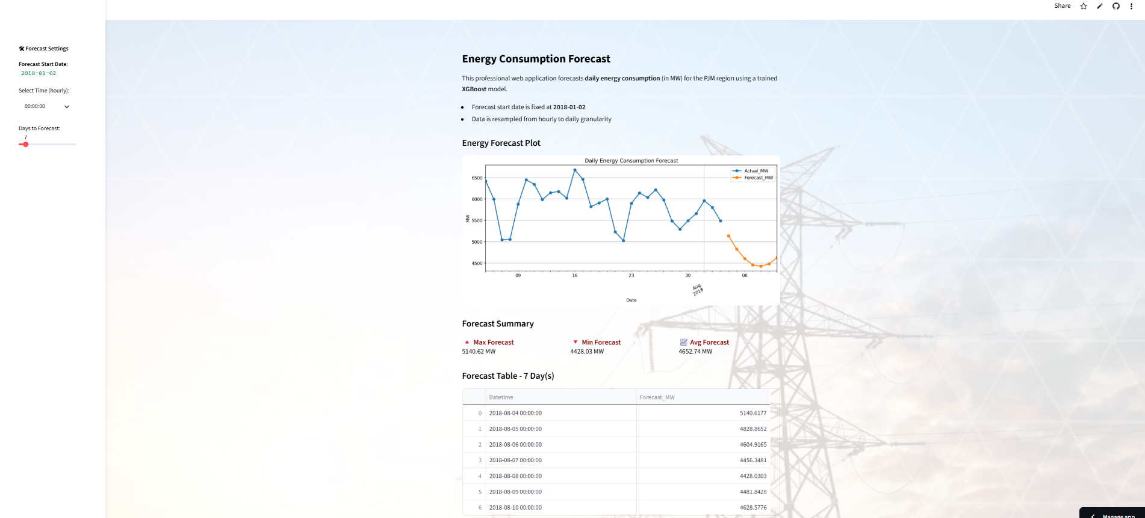
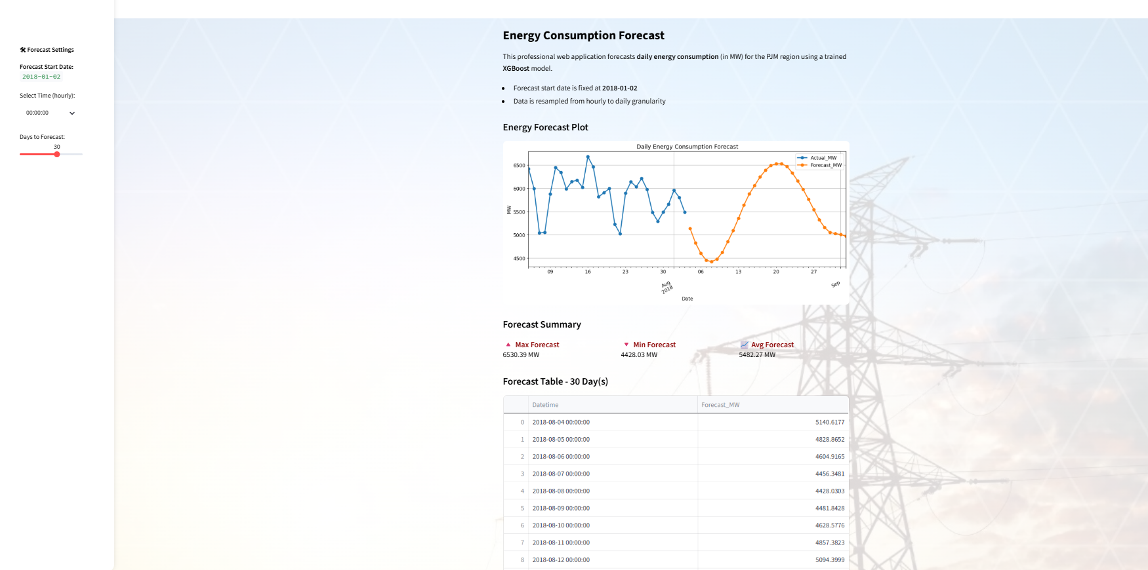
Deployment
Key Insights :
Forecast Visualization : The app shows actual vs. forecasted energy demand, helping track prediction accuracy in real-time.
Summary Metrics : Displays maximum, minimum, and average forecasted demand for the selected period.
Custom Forecasting : User can choose forecast start date, time granularity, and number of days to predict.
Forecast Table : Tabular output provides day-wise predicted values for transparent analysis.
Scalable Design : Supports both short-term (7-day) and extended (30-day) forecasts for operational flexibility.

Slide 23
Challenges & Solutions
Challenges | Solutions
Overfitting risk : XGBoost can overfit if not tuned properly. | Used early stopping and cross-validation to reduce overfitting.
Missing values : Gaps in time series can break lag creation. | Cleaned data before lag creation to fix missing values.
Model interpretability : Hard to explain predictions to non-technical stakeholders. | Used XGBoost feature importance to explain model behavior.
Evaluation bias : Metrics can mislead if test set isn’t representative. | Ensured realistic forecasting scenario with continuous test set.
Scalability : Larger datasets or longer lag windows increase complexity. | Designed modular pipeline for easy scaling and tuning.

Slide 24
Conclusion
We built a strong and reliable time series forecasting system using XGBoost with lag-based features.
The model learned from past data patterns to make accurate predictions.
Delivered low MAE and RMSE, proving it can handle complex and changing trends in energy demand.
From data preparation to deployment, our step-by-step workflow was:
Created lag features to give the model temporal context.
Trained XGBoost with tuned parameters for best performance.
Achieved accurate predictions backed by strong evaluation metrics.
Designed a deployment-ready pipeline that can be integrated into real-world systems.
In short:
We now have a scalable, high-performance forecasting solution that’s ready for production.
Can be further improved with hyperparameter tuning or ensemble methods in the future.

Slide 25
Thank you.
For your time and attention. It was a pleasure presenting our project. We look forward to your feedback suggestions.

